Slide 1

Hand Gesture Recognition on an Embedded Vision System
Team: Tiny AI Hardware
Team Members: Yi Deng, Ziyu Xuan, Chance M Woosley

Slide 2
Project Overview
Goal: Implement a hand-gesture recognition system with embedded hardware
Expected Results: Successful recognition of three different gestures
Evaluation: Recognizing training dataset with 90% accuracy or above. Recognizing Real-time gestures with 85% accuracy or above

Slide 3
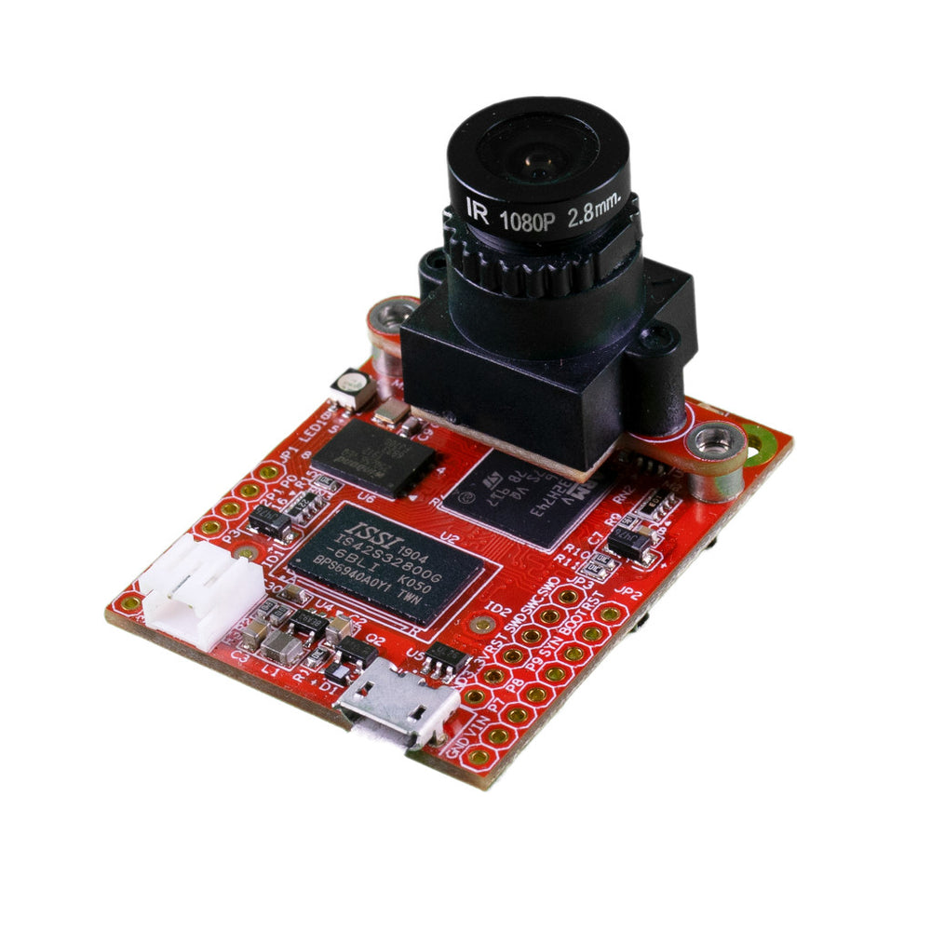
Platform
Hardware: OpenMV H7 Plus
Input device: Camera
Output: RGB LED
Training Platform: Edge Impulse

Slide 4
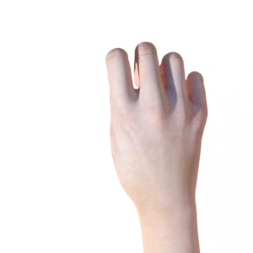
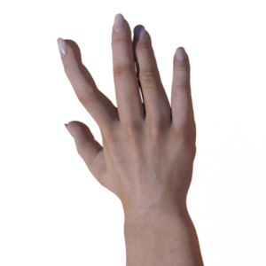
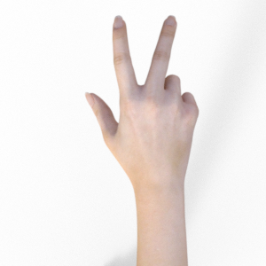
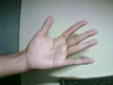
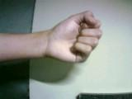

Datasets
Rock-Paper-Scissor Dataset
Our own recorded Dataset

Slide 5
Methodology
Fist: red
Data Collection
MobileNet V2 Model Training
Deployment
Real-time Testing
Palm: green
Pointing: blue
Notes:
For our methodology, we follow a simple end-to-end pipeline.
We first collect images for the three gesture classes using the OpenMV camera, and we also include some public data to make the dataset more diverse.
Next, we upload everything to Edge Impulse and train a lightweight MobileNet model that can run on the microcontroller.
After the model is trained and quantized, we deploy it onto the OpenMV H7 board.
The final step is real-time testing, where the board classifies each gesture live and maps it to different outputs—for example, a red signal for a fist, green for a palm, and blue for a pointing gesture.

Slide 6
Team & Roles
Member | Roles | Responsibilities
Yi Deng | Data & Model | Dataset collection, public dataset integration, EI training & tuning
Ziyu Xuan | Embedded System | Deployment, inference code,
Chance M Woosley | Testing & Documentation | Performance Evaluation, Report writing, GitHub management

Slide 7
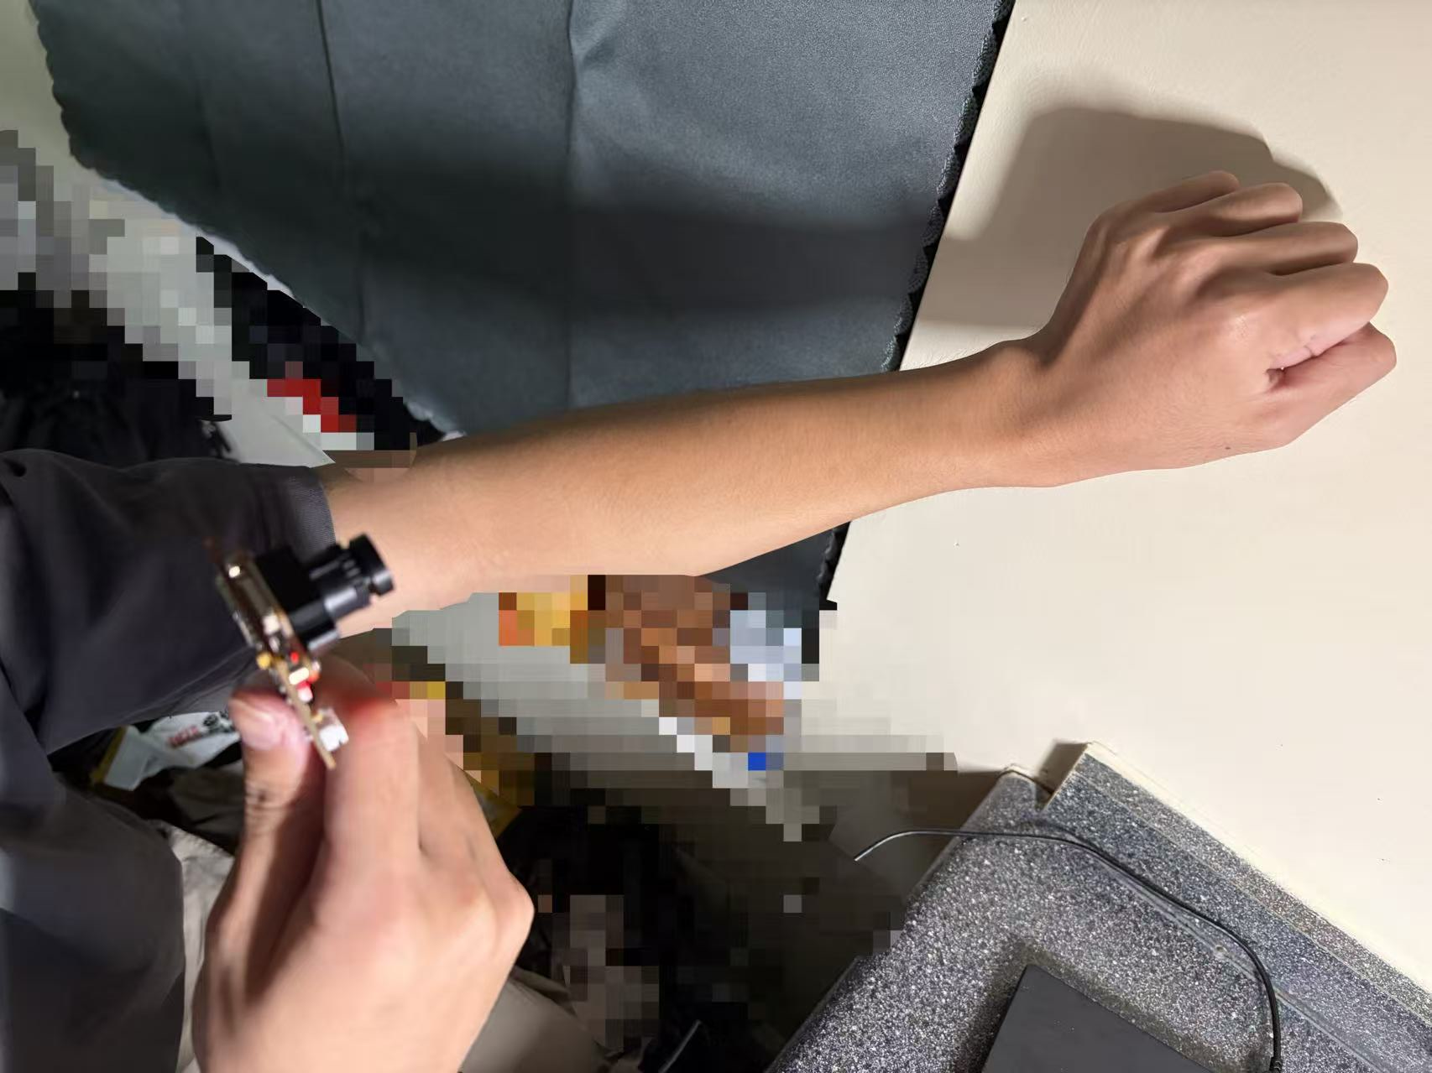
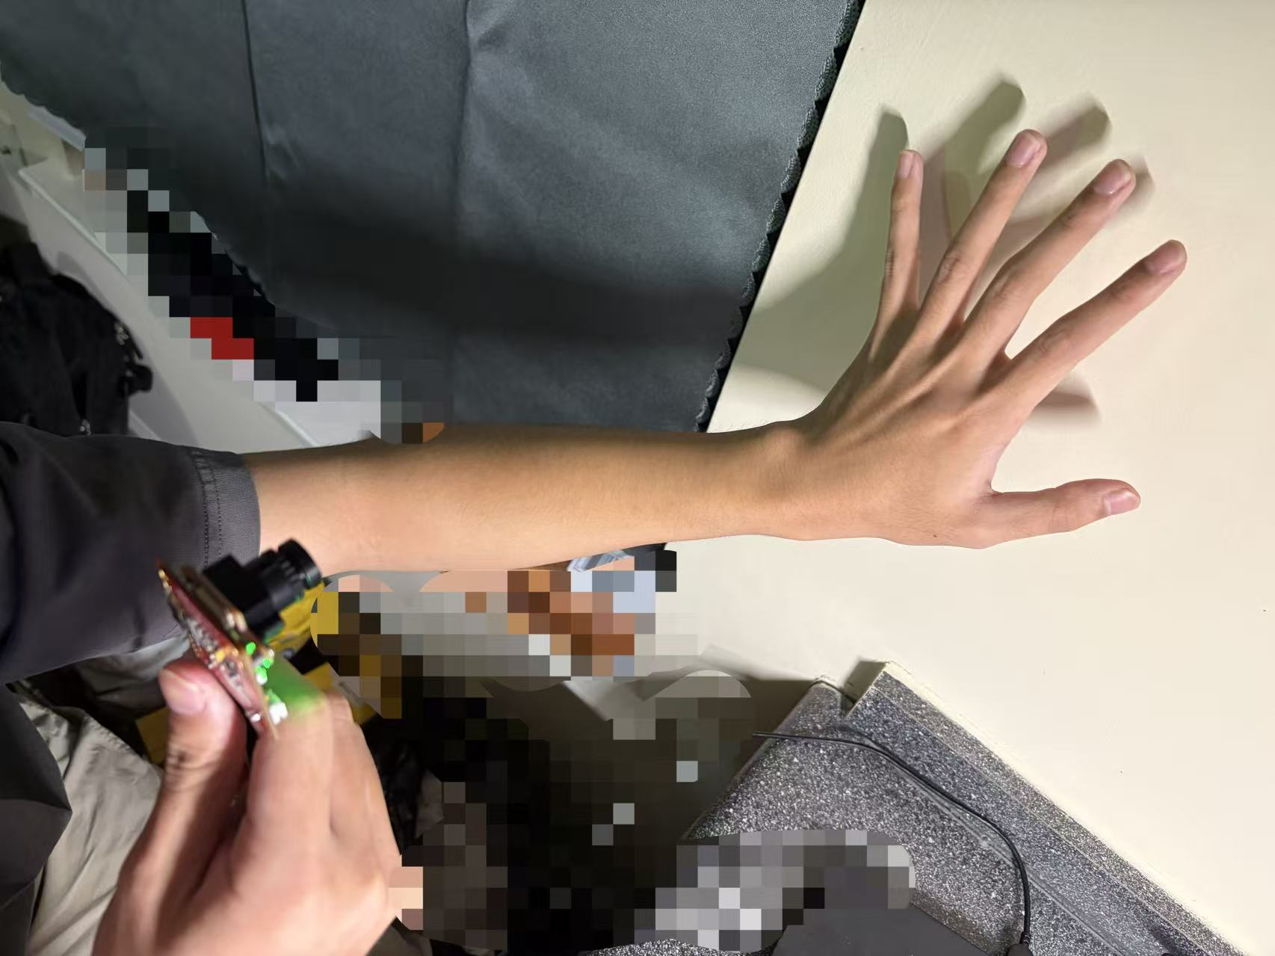
Current Progress
palm
fist

